Slide 1
WHAT
WHY
Business Challenges
Use Case Description
KPIs Impacted
This solution adds an Agentic AI layer over Microsoft Fabric and Power Platform to analyze project updates, detect risks, predict delays, and auto‑update RAG status.
A role‑aware Copilot lets users ask project questions in natural language, while admins securely update actuals, accruals, stages, and RAG.
The system sends automatic alerts when a project turns Red and collects PM explanations through a Power Apps form.
If updates are missing, reminders are triggered via email, Teams, or the AI agent, allowing PMs to submit their updates directly through the conversational interface.
% of projects with accurate and timely RAG updates
% reduction in project delays
Risk prediction accuracy
PMO effort reduction (Time to detect and escalate risks
Quality and consistency of project updates
Important risks stay hidden in unstructured updates, causing inconsistent RAG and late visibility for leadership.
Teams struggle to find information across many tools, and there’s no easy chat option for updates or questions.
There are no proactive alerts or automatic Red‑status escalations, and PMs aren’t asked to explain delays.
Missing or late updates require manual follow‑up with no single, easy workflow.
Agentic AI Powered Project Risk Intelligence with Role Aware Chat
Business Impact
40–60% reduction in PMO manual effort through automated risk analysis
Early detection of hidden risks, reducing slippage and surprise escalations
Faster leadership decision-making via conversational insights
Consistent and explainable RAG scoring across all projects
Scalable project oversight for large portfolios across business units
HOW
Functional Solution
Technical Solution
WHO
Auto-email alerts when a project turns Red
Power Apps form sent to PMs for explaining delays and mitigation
Reminders sent for missing or late updates
PMs can update project status, actuals, and accruals directly through the AI agent
AI analyzes project updates to detect risks and predict delays
Automatically updates RAG status with reasons
Role-aware chat allows users to query any project data
Power Automate flows trigger Red-alert emails and reminders
Power Apps form captures PM explanations and writes them to Dataverse
Microsoft Fabric pipelines detect stale or missing updates
AI models (semantic + sentiment analysis) process project updates
Dataverse stores project data, RAG status, and audit logs
Copilot Studio powers the conversational agent and secure admin actions
Stakeholders
Project Managers & Delivery Leads
PMO Teams
Leadership
Platform/Admin Users

Slide 2
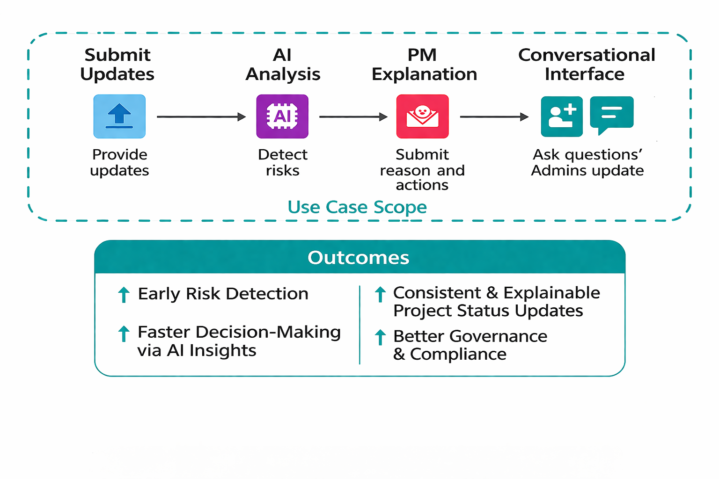
Use Case Scope in the Business Process
+ 40-80%
+ 20-35%
>90+%
+ 50-70%
Faster Campaign Cycle Time
More time on Strategy
Automated QA & Compliance Checks
Productivity (FTE Hours Saved)

Slide 3
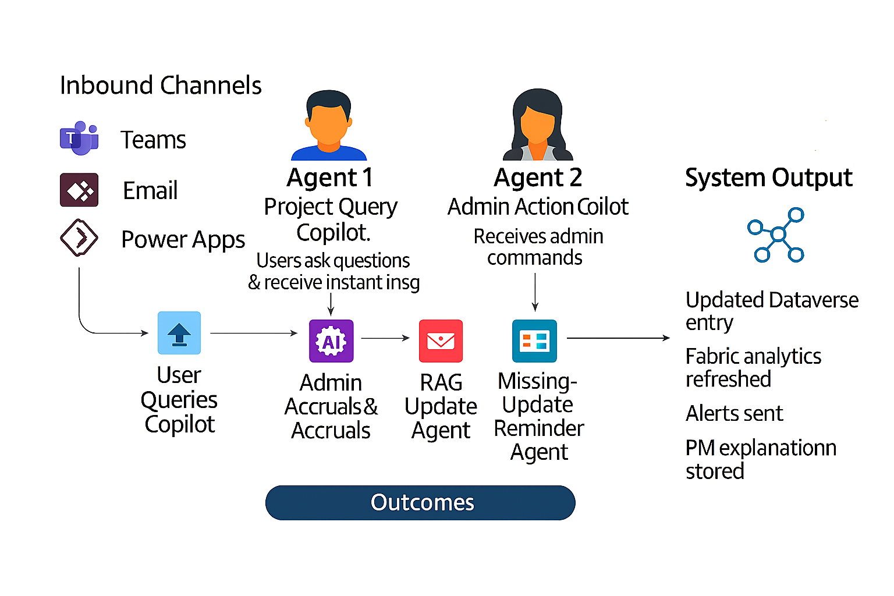
Functional Solution + AI-Human Chemistry

Slide 4
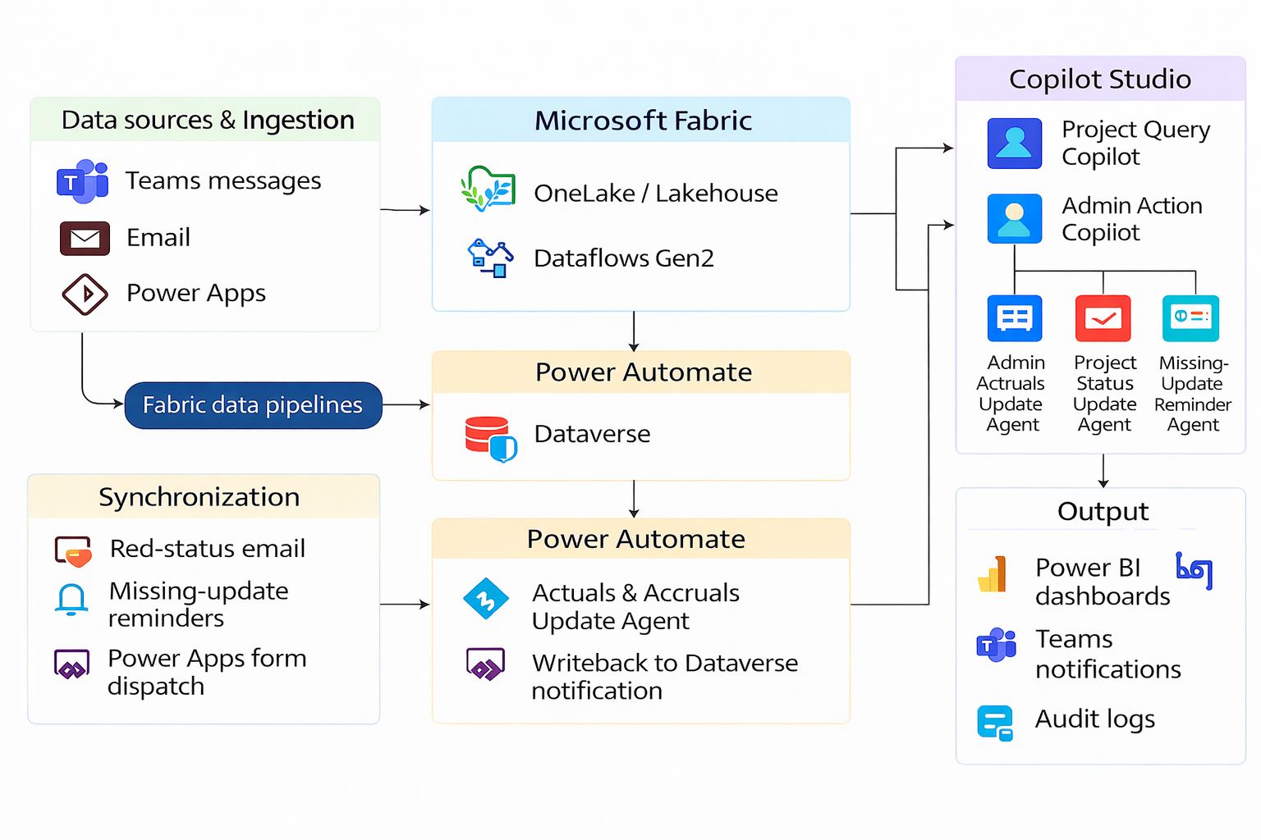
Technical Solution
technologies
Microsoft Fabric
Dataverse
Power Apps
Power Automate
Copilot Studio,
ML Models
Power BI

Slide 5
Business Case Proposal
WHY
BUSINESS CASE
KPIs Impacted
Current Costs
Current Income
30 - 45% Reduction in project delivery risks
50 - 70% Improvement in RAG accuracy & consistency
20 - 30% Increase in on‑time project updates
60 - 80% Faster risk detection & escalation
Running (R1): 0 €
(Current manual governance, no automation)
Maintenance (M1): XXXX €
(Manual PMO review effort, repeated follow‑ups)
TOTAL CURRENT COST (TCC) = R1 + M1
Revenue (Rv1): YYYY €
(Current project revenue with traditional governance)
New Costs
New Income
Business Impact
Implementation (I): XXXX €
(AI pipeline setup, Copilot Studio agents, Fabric integration)
Running (R2): XXXX €
(Model scoring, automation workflows, monitoring)
Maintenance (M2): XXXX €
(Minor updates to models, workflows, governance rules)
TOTAL NEW COST (TNC) = R2 + M2
Revenue (Rv2): YYYY €
(Expected uplift due to faster decisions, reduced delays, improved delivery confidence)
Agentic AI improves project governance by detecting risks early, auto‑updating RAG, and reducing delays through proactive alerts. Leadership gains real‑time visibility, while PMs receive guided workflows to explain risks and submit updates. This reduces manual effort, improves update quality, speeds decision‑making, and increases overall portfolio health and delivery reliability.

